Slide 1
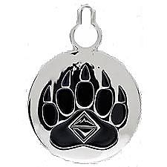
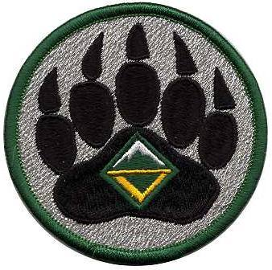
Kodiak Challenge Overview
MATIANUCK DISTRICT ROUNDTABLE
FEBRUARY 2017

Slide 2
What is Kodiak?
Leadership development course
Experiential education
Outside comfort zone; challenging adventure setting
6 day trek/trip/activity or 2 3-day weekends
Older teens (14+; 13+ for Venturers)
Offered by troop/crew, district, or council
Servant leadership
Council approval 3+ months ahead
Prerequisite: ILST/ILSC
Must follow official syllabus

Slide 3
 | Kodiak | NYLT
Leadership Concepts | Servant Leader focus; similar leadership skills
 | focus on practicing & reflecting | focus on learning & practicing
Setting | Real-life outdoor adventure | Artificial to mimic “life in the month of a unit”
Time | 6 days or 2 weekends + pre-trek planning for youth & staff | 6 days or 2 weekends + ~5 development weekends for staff
Age | 14+ Scouts, 13+ Venturers
Size | 5 - 8 participants + staff | 48 - 64 participants + staff
Syllabus | Must follow; work in to trek schedule | Must follow; detailed schedule
Run by… | Unit, District, or Council | National course run by Council
Formal Approval Required | Council | Council + Area
Staff (Course Leadership) | Shared youth/adult | Youth-led training, adult support
Prerequisite | ILST/ILSC; NYLT encouraged | ILST/ILSC

Slide 4
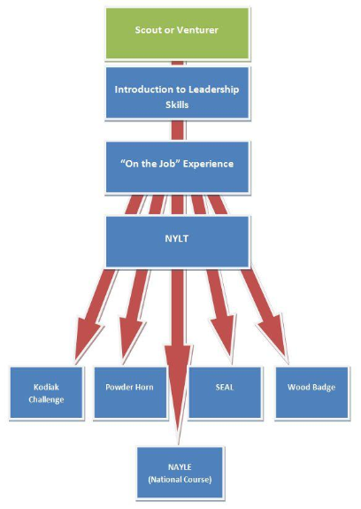
Where Kodiak Fits In
Be a Scout or Venturer
Scout: 14+
Venturer: 13+
Complete ILST/ILSC
Then Kodiak
(…ideally after NYLT)
NYLT & NAYLE encouraged before Kodiak

Slide 5
Schedule & Leadership Skills
Pre-trek
Pre-trek
Day 1
Day 2
Day 3
Day 4
Day 5
Post-trek
Creating a Shared Vision of Success
Planning
Communication
Stages of Team Development
Inclusiveness
Values & Ethical Decision Making
Servant Leadership / Leadership Styles
Debrief

Slide 6
“Kodiak is not about the trek; it is about Leadership Skills”
Present 1+ activity each day of the trek to reinforce one of the Leadership Skills
Staff watches for something that happens (good or bad) that reinforces a Leadership Skill
Evening reflection: Real-life experience of the adventure to reinforce leadership
lessons

Slide 7
Trek Ideas
Backcountry Adventure
40-mile Appalachian Trail backpacking
Remote canoe trip
Community-Based Adventure
Church service mission
Art/science museum tour (Washington D.C., NYC, Revolutionary War battlegrounds, etc.)
High Adventure Base
Philmont, Northern Tier, SeaBase
Professional outfitter
Local high adventure base (Chilkoot, Maine, etc.)
World Scout Jamboree
Local Council Camp Kodiak Week

Slide 8
Kodiak Trek Staff
Adults & older youth
Senior Kodiak Guide (Course Director) Adult
Associate Guide – Logistics Adult/Youth
Associate Guide – Instruction Youth/Adult
Kodiak Guide Youth
Others as needed: Safety Officer,
Quartermaster, Trek Skill Specialist,
etc.

Slide 9
Kodiak Syllabus
74 pages!
Helpful outside Kodiak, too (troop meetings, ILST supplement activities)
Lots of good ideas for learning skills
What to look for – evidence of skills
Other tools
Teamwork Survey – What stage are you?
Leadership Quality Assessment

Slide 10
Kodiak Syllabus: Other Tools
Icebreakers
Games to facilitate…
Shared Vision of Success (Escape from Sinking Ship / String Maze)
Planning (Giant Pods, Laser Wall)
Communication (Charades, Animal Lineup, Birthday Lineup)
Understanding Stages of Team Development
Understanding Servant Leadership
Understanding Inclusiveness

Slide 11
What Do You Think?
Can you see offering a Kodiak trek in your troop?
Maybe for your Scouts who have been to NYLT?
Would you want that much structure on a high adventure trip? Would your scouts?
Should District or Council offer Kodiak?
Should our summer camps?
Morning activities for older scouts –
Adventure Treks/CAPE on steroids

Slide 12
Thank You

