Slide 1
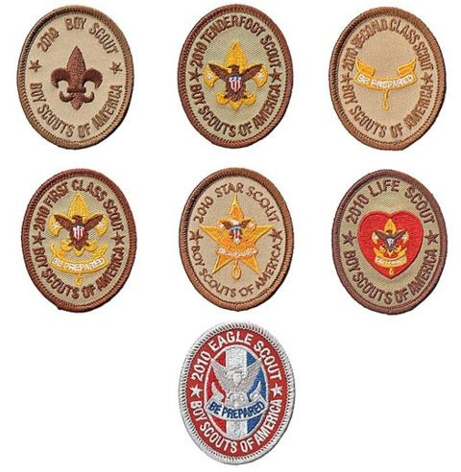
Introduction to Leadership Skills for Troops
Robert Hazzard
February 20, 2016

Slide 2
Today’s Agenda
Module One—Troop Organization includes a description of each leadership position in the troop, including roles and responsibilities, troop organization, and introductions to vision and servant leadership. (About an hour…)
Module Two—Tools of the Trade covers some core skill sets to help the Scout lead, including communicating, planning, and teaching. (About an hour and a half…)
Module Three—Leadership and Teamwork incorporates additional leadership tools for the Scout, including discussions of teams and team characteristics, the stages of team development and leadership, inclusion/using your team, ethics and values of a leader, and a more in-depth review of vision. (About an hour…)

Slide 3
Introduction to this Course
Leadership in Boy Scouting
  Leadership is a vital part of the Scouting program.
  Opportunities to develop leadership skills are a key part of Scouting – every bit as important as rank!
  Key activities of youth leaders…
Organizing the troop
Planning and organizing activities and meetings
Assigning duties to others
Planning menus and figuring out food costs
Encouraging advancement
Guiding a troop’s involvement in problem-solving
Teaching outdoor, sports, or craft skills
Ensuring the troop’s safety during meetings and outings
Handling the troop’s finances
Helping other Boy Scouts make the most of their own leadership opportunities
Encouraging participation

Slide 4
Youth Training Continuum
Taught at the
Regional/National Level
Taught at the
Unit Level
Taught at the
Council Level
ILST
NYLT
NAYLE

Slide 5
Module One – Unit Organization
Module Overview
  Introduction to the Course - 5 minutes
  Introduction to Vision - 5 to 10 minutes
  Troop Organization - 20 to 35 minutes
  The Team-Based Troop - 25 to 30 minutes
  Introduction to Servant Leadership - 5 to 10 minutes

Slide 6
Introduction to the Course
The purpose of this course
Where ILST fits into Scouting’s Youth Training Continuum
  ILST to NYLT to NAYLE
Course logistics
  Food
  Restrooms
  Breaks
  Phone calls and cell phone/texting etiquette
  Personal etiquette
ILST
NYLT
NAYLE

Slide 7
Introduction to Vision
Critical to success in any role or project
Developed and shared by all members
Share and discuss the vision of the Senior Patrol Leader (SPL) and Scoutmaster

Slide 8
Scoutmaster Vision of Success
Leadership
The Troop will be a strong “Boy led/Adult Guided” Troop using the Patrol method, with patrols and scouts that work together to provide opportunities for fun, advancement and outdoor adventure, guided by the principles of the Scout Oath and Law.
The Senior Patrol Leader will efficiently and effectively run fun and informative troop meetings, with an emphasis on meeting the objectives planned by the PLC.
Under the direction of the Assistant Senior Patrol leader, all other boy leaders within the troop (quartermaster, historian, chaplain’s aide, scribe, librarian, OA Rep and historian) will work to achieve personal position goals that they set to help the troop succeed.
The PLC, under direction of the SPL, will plan meetings and activities to make advancement opportunities available to the boys for opportunity for new scouts to earn the First Class rank within 18 months .
ILST training will be provided to all scouts with leadership roles, reinforced by guidance and mentoring by adult leaders in the Troop. SPL, ASPL and upcoming scout leaders will participate in NYLT to further improve leadership skills.
The Scoutmaster will set aside time specifically for the coaching and mentoring of the SPL and other troop and patrol leaders.
Service
The Troop will expand it’s efforts for community service and events, looking for opportunities beyond our Charter Organization, and encouraging service in OA.
Scout Skills
The Troop will continue instruction of basic scout skills and look for challenges and opportunities to learn other skills or advanced skills as part of outdoor adventure and advancement that have not been done before (pioneering, geocaching, backpacking, rockclimbing, etc).
Troop meetings will include skill instruction guided by scouts or adults upon request, and related activities (games, competitions, challenges).
Notes:
8

Slide 9
Troop Organization
Organization (chart)
Note youth alignment to adult positions
Note the youth positions have responsibilities to one another
Youth positions are both elected and appointed

Slide 10
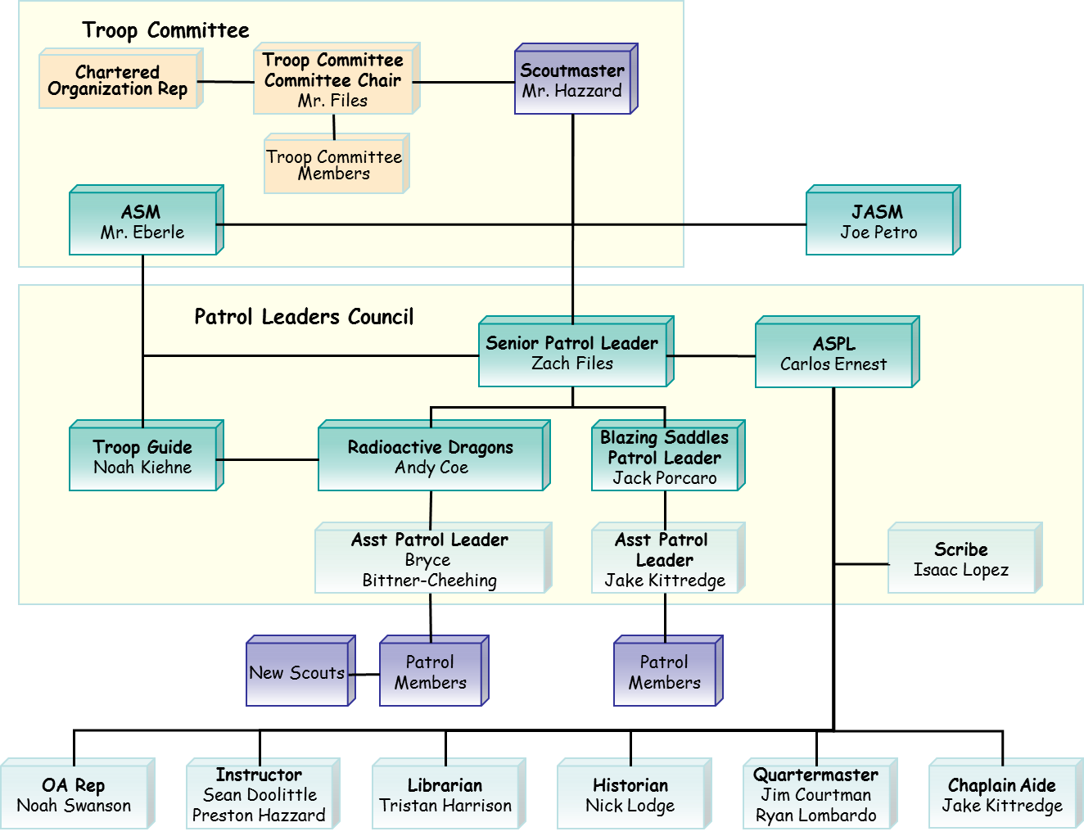
Troop 203 Organization - 2016

Slide 11
Scout Positions
Senior Patrol Leader
Assistant Senior Patrol Leader
Patrol Leader
Assistant Patrol Leader
Troop Guide
Den Chief
Historian
Librarian
Order of the Arrow Representative
Quartermaster
Scribe
Instructor
Chaplain’s Aide
Webmaster
LNT Trainer
Jr. Ass’t Scoutmaster

Slide 12
Senior Patrol Leader
Preside at all troop meetings, events, activities, and annual program planning conference.
Chair the patrol leaders’ council.
Appoint Scout leaders with the advice and consent of the Scoutmaster.
Assign duties and responsibilities to other Scout leaders.
Work with the Scoutmaster in training Scout leaders.
Set and enforce the tone for good Scout behavior within the troop.
Set a good example.
Wear the Scout uniform correctly.
Live by the Scout Oath and Scout Law.
Show and help develop Scout spirit.

Slide 13
Assistant Senior Patrol Leader
Be responsible for training and giving direct leadership to the following appointed Scout leaders:
  Historian,
  Order of the Arrow troop representative,
  Scribe,
  Librarian,
  Instructor,
  Quartermaster, and
  Chaplain aide
Help lead meetings and activities as called upon by the senior patrol leader.
Guide the troop in the senior patrol leader’s absence.
Perform tasks assigned by the senior patrol leader.
Function as a member of the patrol leaders’ council.
Help set and enforce the tone for good Scout behavior within the troop.
Set a good example.
Wear the Scout uniform correctly.
Live by the Scout Oath and Scout Law.

Slide 14
Patrol Leader
Plan and lead patrol meetings and activities.
Keep patrol members informed.
Assign each patrol member needed tasks and help them succeed.
Represent the patrol at all patrol leaders’ council meetings and the annual program planning conference.
Prepare the patrol to take part in all troop activities.
Show and help develop patrol spirit.
Work with other troop leaders to make the troop run well.
Know what patrol members and other leaders can do.
Set a good example.
Wear the Scout uniform correctly.
Live by the Scout Oath and Scout Law.

Slide 15
Assistant Patrol Leader
Help the patrol leader plan and lead patrol meetings and activities.
Help the patrol leader keep patrol members informed.
Help the patrol leader prepare the patrol to take part in all troop activities.
Lead the patrol in the patrol leader’s absence.
Show and help develop patrol spirit.
Represent the patrol at all patrol leaders’ council meetings in the patrol leader’s absence.
Work with other troop leaders to make the troop run well.
Set a good example.
Wear the Scout uniform correctly.
Live by the Scout Oath and Scout Law.

Slide 16
Troop Guide
Introduce new Scouts to troop operations.
Guide new Scouts through early Scouting activities.
Help set and enforce the tone for good Scout behavior within the troop.
Ensure older Scouts never harass or bully new Scouts.
Help new Scouts earn the First Class rank in their first year.
Coach the patrol leader of the new-Scout patrol on his duties.
Work with the patrol leader at patrol leaders’ council meetings.
Attend patrol leaders’ council meetings with the patrol leader of the new-Scout patrol.
Assist the assistant Scoutmaster with training.
Coach individual Scouts on Scouting challenges.
Set a good example.
Wear the Scout uniform correctly.
Live by the Scout Oath and Scout Law.
Show and help develop Scout

Slide 17
Historian
Gather pictures and facts about past activities of the troop and keep them in scrapbooks, wall displays, or information files.
Take care of troop trophies and keepsakes.
Keep information about troop alumni.
Set a good example.
Set a good example.
Wear the Scout uniform correctly.
Live by the Scout Oath and Scout Law.
Show and help develop Scout spirit.

Slide 18
Order of the Arrow Troop
Representative
Serve as a communication link between the lodge or chapter and the troop.
Encourage year-round and resident camping in the troop.
Encourage older-Scout participation in high-adventure programs.
Encourage Scouts to actively participate in community service projects.
Assist with leadership skills training in the troop.
Encourage Arrowmen to assume leadership positions in the troop.
Encourage Arrowmen in the troop to be active participants in lodge and/or chapter activities and to seal their membership in the Order by becoming Brotherhood members.
Set a good example.
Wear the Scout uniform correctly.
Live by the Scout Oath, Scout Law, and OA Obligation.
Show and help develop Scout spirit.

Slide 19
Librarian
Establish and maintain a troop library.
Keep records on literature owned by the troop.
Add new or replacement items as needed.
Have literature available for borrowing at troop meetings.
Maintain a system to check literature in and out.
Follow up on late returns.
Set a good example.
Wear the Scout uniform correctly.
Live by the Scout Oath and Scout Law.
Show and help develop Scout spirit.

Slide 20
Quartermaster
Keep records of patrol and troop equipment.
Keep equipment in good repair.
Keep equipment storage area neat an
Issue equipment and see that it is returned in good order.
Suggest new or replacement items.
Work with the troop committee member responsible for equipment.
Set a good example.
Wear the Scout uniform correctly.
Live by the Scout Oath and Scout Law.
Show and help develop Scout spirit.

Slide 21
Scribe
Attend and keep a log of patrol leaders’ council meetings.
Record attendance and dues payments of all troop members.
Record advancement in troop records and on the troop advancement chart.
Set a good example.
Wear the Scout uniform correctly.
Work with the appropriate troop committee members responsible for finance, records, and advancement.
Live by the Scout Oath and Scout Law.
Show and help develop Scout spirit.
Handle correspondence appropriately.

Slide 22
Instructor
Instruct Scouting skills as needed within the troop or patrols.
Prepare well in advance for each teaching assignment.
Set a good example.
Wear the Scout uniform correctly.
Live by the Scout Oath and Scout Law.
Show and help develop Scout spirit.

Slide 23
Chaplain’s Aide
Keep troop leaders apprised of religious holidays when planning activities.
Assist the troop chaplain or religious coordinator in meeting the religious needs of troop members while on activities.
Encourage saying grace at meals while camping or on activities.
Lead worship services on campouts.
Tell troop members about the religious emblems program for their faith.
Set a good example.
Wear the Scout uniform correctly.
Live by the Scout Oath and Scout Law.
Show and help develop Scout spirit.

Slide 24
Junior Assistant Scoutmaster
Function as an assistant Scoutmaster (except for leadership responsibilities reserved for adults 18 and 21 years of age or older).
Accomplish any duties assigned by the Scoutmaster.
Set a good example.
Wear the Scout uniform correctly.
Live by the Scout Oath and Scout Law.
Show and help develop Scout spirit.

Slide 25
Adult Troop Positions
Adults in the troop are responsible for providing training to troop leadership and enabling them to carry out their duties.
They also provide resources for the troop leaders and serve as mentors to all Scouts in the troop.
The number of adult leaders and committee members needed is dependent on the size and needs of the troop.

Slide 26
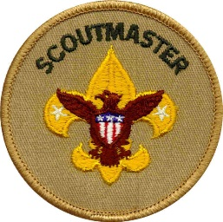
Scoutmaster
Train and guide boy leaders.
Work with other responsible adults to bring Scouting to boys.
Use the methods of Scouting to achieve the aims of Scouting.
Meet regularly with the patrol leaders’ council for training and coordination in planning troop activities.
Attend all troop meetings or, when necessary, arrange for a qualified adult substitute.
Attend troop committee meetings.
Conduct Scoutmaster conferences for all rank advancement.
Conduct periodic parents’ sessions to share the program and encourage parent participation and cooperation.
Provide a systematic recruiting plan for new members and see that they are promptly registered.
Delegate responsibility to other adults and groups (assistants, troop committee) so they have a real part in troop operations.
Conduct all activities under qualified leadership, safe conditions, and the policies of the chartered organization and the Boy Scouts of America.

Slide 27
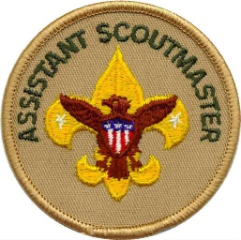
Assistant Scoutmasters
To fulfill his or her obligation to the troop, the Scoutmaster, with the assistance of the troop committee, recruits assistant Scoutmasters to help operate the troop.
Each assistant Scoutmaster is assigned specific program duties and reports to the Scoutmaster.
They also provide the two-deep leadership required by the Boy Scouts of America (there must be at least two adults present at any Boy Scout activity).
An assistant Scoutmaster may be 18 years old, but at least one in each troop should be 21 or older so he or she can serve in the Scoutmaster’s absence.

Slide 28

Committee Chair
Supervises the Scoutmaster and committee members.
Recruits and approves Scoutmasters and committee members.

Slide 29

Committee Member
Serves as a resource to the troop.
Works with an assigned officer.
Recruits consultants.
Potential Roles
  Webmaster
  Treasurer
  Secretary
  Merit Badge Coordinator
  Quartermaster
  Eagle Scout Coordinator
  Camping Coordinator

Slide 30

Chartered Organization
Representative
Serves as the liaison between the troop and the chartered organization.
Recruits the troop committee; approves Scoutmasters and committee members.
Participates in district leadership.

Slide 31
Roles & Responsibilities - Breakout
Role Balancing – Balloon Toss
  Reflection…

Slide 32
The Scout-Led Troop
Group Discussion: Leadership in Scouting
  Discuss leadership in Scouting and the value of
  the Scout-led troop
Game: Yurt Circle
  Reflection:
  Key teaching points:

Slide 33
The Scout-Led Troop
Group Discussion: Patrol Leader’s Council
Game: Helium Stick
  Reflection:
  Key points:

Slide 34
The Scout-Led Troop
Group Discussion: Define leadership
Group Discussion: Tips for Being a Good Leader in the Troop
Game: Willow in the Wind

Slide 35
Introduction to Servant Leadership
Group Discussion: Why Should Scouts Choose to Be Leaders?
  Reflection:
  Key points:

Slide 36

Break!
Take 10 minutes…

Slide 37
Module Two– Tools of the Trade
Module Overview
  Introduction to the Tools of the Trade Session – 5 mins
  Communications – 20 to 30 minutes
  Planning – 20 to 30 minutes
  The Teaching EDGE – 15 to 25 minutes

Slide 38
Introduction to the Tools of the Trade
Communications – The skills of being an effective listener and an effective communicator are valuable tools for any leader.
Planning – Proper planning makes the difference in almost all Scouting activities.
Teaching EDGE – The Teaching EDGE method can be used any time a leader is helping others learn.

Slide 39
Communications
Basic Parts of ANY communication:
  A sender → A message → A receiver
  This is still a valid model today. It applies to all forms of communication: verbal, written, music, film, signaling, pantomime, teaching, etc.
Game: Receiving
  Reflection:
  Key points:

Slide 40
Key Listening Tips:
Listen with your eyes as well as with your ears. Watch for nonverbal cues.
Avoid distractions, both physical and mental. Give the speaker your full attention.
Try to see things from the speaker’s point of view. In other words, try to put yourself in the speaker’s shoes.
Apply the ideas to yourself. Think about how the speaker’s message relates to you and your experiences.
Ask questions if you are unclear about anything.
Review the speaker’s points and think what logically might come next in the message.
Curb your desire to talk until the speaker has finished.
Respond nonverbally (nod your head or smile) to the speaker.
Practice listening with respect for the speaker. Work hard not to interrupt even when you have a burning desire to make a point.

Slide 41
Effective Messages
Game: The Whole Picture
  Reflection:

Slide 42
Effective Messages - Tips
Organize your thoughts
Minimize distractions
Get the audience’s attention first
Speak clearly and make eye contact
Repeat facts such as dates, times, and places.
Distribute notes

Slide 43
Planning
Second only to communicating, good planning is an essential skill for every effective leader.
  At its core, planning is really just thinking ahead
Ask questions – develop answers
After initial planning (also called “happy path” planning), start asking “what if” questions
  Adjust your plan to accommodate the unexpected
  Next add the “who” – the resources to make it happen

Slide 44
Planning
Group Exercise: Planning
  Plan as a group a sample troop service project
  Scenario: On a Saturday, six weeks from now, the troop will conduct a service project at a local city park. The project involves:
    Installing 50 feet of split-rail fence around a tree (to protect it)
    Removing old plants and undergrowth from a nearby area (approximately 500 square feet in area). Laying down weed block in the cleared area. Spreading 6 cubic yards of mulch in the area just cleared and under the fenced-in tree
    Planting 15 to 20 small plants and shrubs in a small garden in a third area nearby
    All areas are within line of sight of each other.

Slide 45
Planning (exercise)
Task:
  Plan what equipment you need for the project and how you’re going to get it. Plan how to use and manage your team on the day of the project.
  Reflection – about the planning session
  Reflection – about the project
  Key points:

Slide 46
Teaching EDGE
The EDGE (Explain, Demonstrate, Guide, Enable) method is the primary training method to teach skills in the troop.
EDGE should be used for all teaching opportunities. Make it a habit.
It can be used anytime a leader is helping others learn.

Slide 47
The Four-Step EDGE Process
  Explain -The trainer explains how something is done.
  Demonstrate - After the trainer explains, the trainer demonstrates while explaining again. This gives the learner a clear understanding of what success looks like.
  Guide - The learner tries the skill while the trainer guides him through it. The trainer gives instant feedback as the learner practices the skill.
  Enable - The learner works independently under the watchful eye of the trainer. The trainer helps remove any obstacles to success, thus enabling the learner to succeed.
Sample skill instruction
Reflection:
Notes:
Some sample skills to teach:
• How to build/fold a paper airplane
• How to properly fold the U.S. flag (refer to page 31, of the BSA publication Your Flag)
• How to tie a knot
• How to perform a basic first-aid activity
• How to toss a small object into a coffee can from a short distance
• How to properly lace up a hiking boot (or tie a shoe)

Slide 48
Tools of the Trade (Wrap-up)
Communications, planning, and teaching —are core skills leaders can use any time they are working with their team
Good planning is foundational to everything
As you grow in Scouting and take on more leadership roles, your leadership skills and strengths will continue to grow over time.

Slide 49

Break!
Take 15 minutes…

Slide 50
Module Three – Leadership & Teamwork
Module Overview
  Introduction to Leadership and Teamwork Session - 5 minutes
  Teams and Team Characteristics - 5 to 10 minutes
  Stages of Team Development and Styles of Leadership - 15 to 25 minutes
  Inclusion - 10 to 15 minutes
  Leadership Ethics and Values - 15 to 25 minutes
  Vision - 5 minutes
  Wrap Up the Introduction to Leadership Skills for Troops Course - 5 minutes

Slide 51
Introduction to Leadership and Teamwork Session
Discussion: What do we mean by “team”?
  Characteristics of effective teams? (list on a board)
Notes:
Setup Required - Game: Integrity Game—Part 1, Setting the Stage. Sometime during the first 15 to 20 minutes of
Module Three, put out a tray of cookies or small wrapped candies for the Scouts. Before putting
out the tray—and without the Scouts seeing you—count the number of Scouts in attendance.
Then count out enough cookies or candies so each Scout can get two pieces, plus have a few
more (one to four) pieces left over on the tray. The Scouts should not be aware of this counting
and preparing. Simply put the tray out and tell the Scouts that they may take two pieces any time
during the session as a reward for their participation in the class.

Slide 52
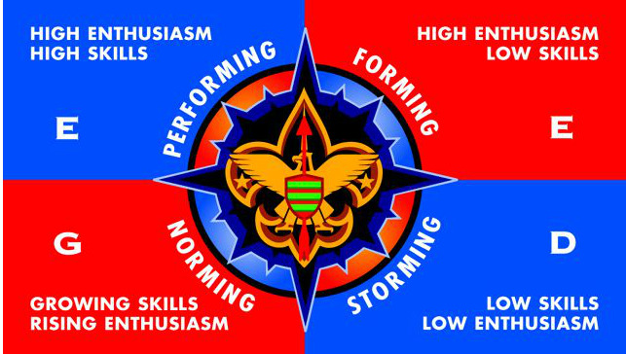
Stages of Team Development
Discussion: How do teams develop?
  Review team development through a discussion
  Leading EDGE
Notes:
Teams go through various stages of development as they come together. Individual people go through the same stages—and their natural ups and downs—as they take on new tasks or roles.
To get a better sense for how this might work in a team, let’s first look at how it works in us as individuals.

Slide 53
Where the Group Is
Stages:
  Starting out (skills are low, enthusiasm is high)
  Becoming discouraged (skills and enthusiasm are low)
  Making progress (skills and enthusiasm is rising)
  Finding success (skills and enthusiasm are high)
Team Skill Level and Enthusiasm
  Skill Level – rises over time
  Enthusiasm – varies as the team develops
Discussion: How can the leader affect the team’s development?
Notes:
Team Skill Level and Enthusiasm
• Skill Level—Generally, the skill level of the team starts low and increases as the team
grows together and gets better at working as a team.
• Enthusiasm—Often, unlike skill level, enthusiasm usually starts out high but can then
take a sudden dip. Then, as the team members explore their differences and align their
expectations with reality, the team begins to achieve results and enthusiasm begins to
rise again.
Ultimately, both enthusiasm and skill level are high as the team becomes a high-performing team.

Slide 54
Inclusion
Effective engagement, inclusion and the use of each member of your team is an important skill
Game: The Potato Game
  Discussion:
  Reflection:

Slide 55

Inclusion (Rocks)

Slide 56
Leadership Ethics and Values
Discussion: Scout Oath
  “On my honor…”
  “…I will do my best…”
  “…to do my duty…”
  “…to God and my country…”
  “… and to obey the Scout Law…”
  “…to help other people at all times…”
  …to keep myself physically strong…”
  “…mentally awake…”
  “…and morally straight.”

Slide 57
Leadership Ethics and Values
Discussion: Scout Law
  A Leader is... Trustworthy,
  A Leader is... Loyal,
  A Leader is... Helpful,
  A Leader is... Friendly,
  A Leader is... Courteous,
  A Leader is... Kind,
  A Leader is... Obedient,
  A Leader is... Cheerful,
  A Leader is... Thrifty,
  A Leader is... Brave,
  A Leader is... Clean,
  A Leader is... and Reverent.
Notes:
The Scout Law. As in the Boy Scout Handbook, break out each word of the Scout Law
individually and discuss it together briefly—with a focus on applying it as a leader in the troop.
Remember, the Scout Law is for everyone. Before each point of the Scout Law, insert “A Scout
leader is.”
For example:
• A Scout leader is trustworthy . . .
• A Scout leader is loyal . .

Slide 58
Leadership Ethics and Values
Did you know you’ve been playing the Integrity Game?
  Leader comments…

Slide 59
Leadership Ethics and Values
The Servant Leader
  Relationship between a leader and the team?
  The role of a leader
  Recognizing responsibilities
  A leader enables the success of the team
  Good and bad examples of leadership
  Be tuned in to the needs and communications
  of the team

Slide 60
Leadership Ethics and Values
Servant Leaders:
  Need to listen and know when the time for discussion is over.
  Achieve consensus and know when to preserve things that are good without foundering in a constant storm of question and reinvention.
  Set/maintain standards and know when to reject what does not maintain those standards or the team vision.
  Serve their customers and know how to make a difference with the team.
Notes:
Go through this slide, and then ask the group:
Please think about how you can be a servant leader in your current role in the troop.

Slide 61
Vision
Discussion: What is YOUR Vision of Success for Troop 203?
  How will we use our leadership skills to reach this success?
  How can we support our new Scout leaders achieve their goals and be successful?

Slide 62
Wrap-Up to the Course
Thanks for attending!
Bring this new enthusiasm and training to your roles and your patrols
Use the other leaders around you
Make a difference!

Slide 63
QUESTIONS?
63

